Slide 1
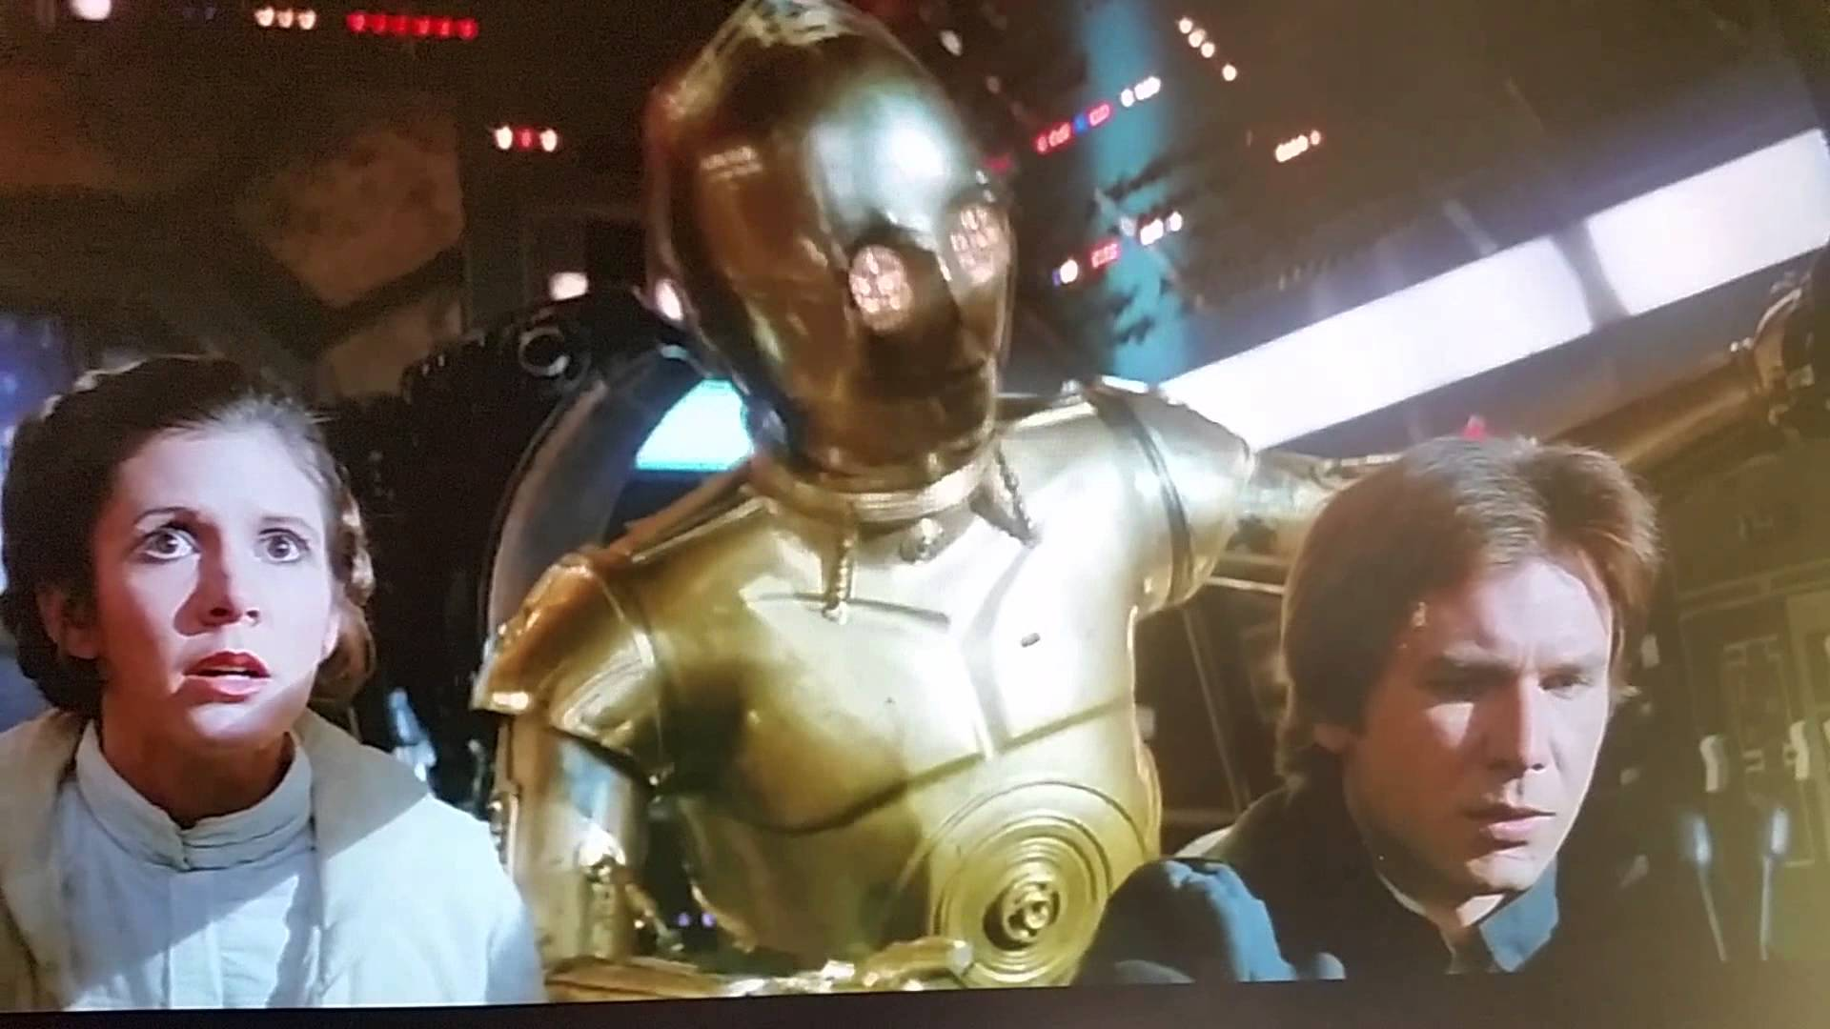
SOEE1475 Statistics and Data Analysis
Lecture 1: Probability
Graeme T. Lloyd

Slide 2

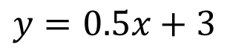
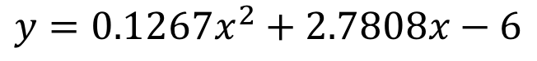
Lesson #1
x | y
10 | 9.14
8 | 8.14
13 | 8.74
9 | 8.77
11 | 9.26
14 | 8.10
6 | 6.13
4 | 3.10
12 | 9.13
7 | 7.26
5 | 4.74
Model A
$$y=0.5x+3$$
Model B
$$y={0.1267x}^{2}+2.7808x−6$$

Slide 3
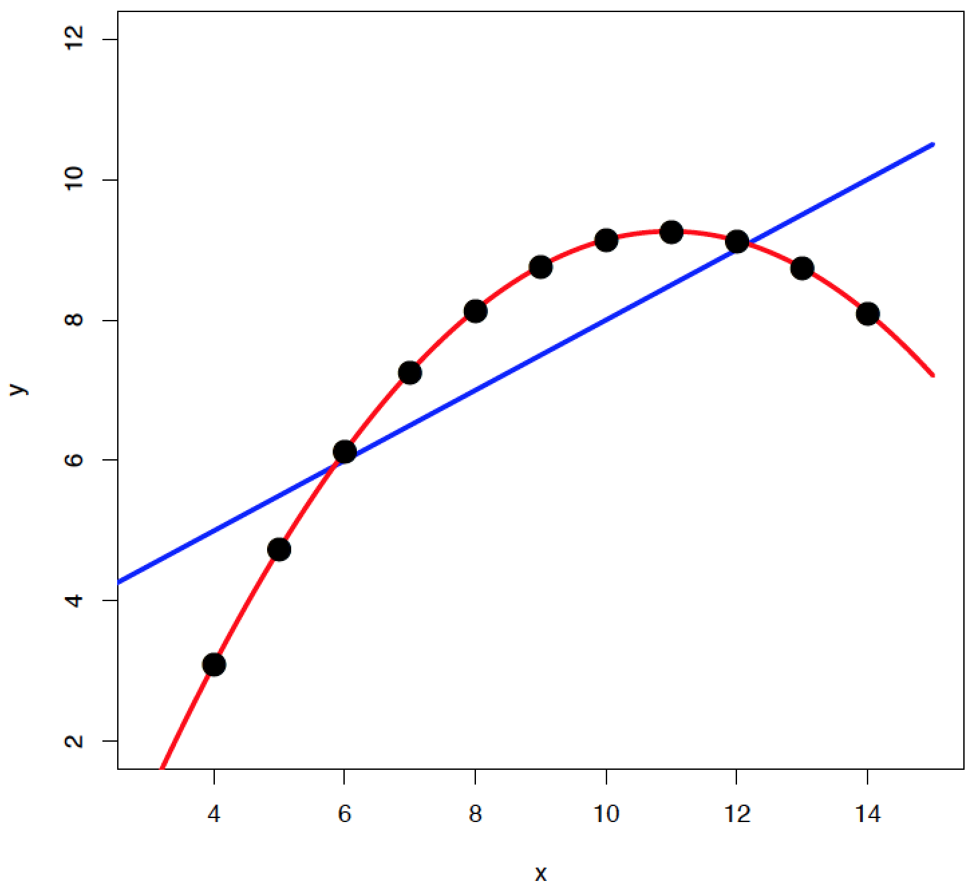
Lesson #1
Model A
Model B

Slide 4
Lesson #1
Always plot your data

Slide 5
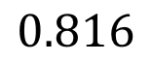
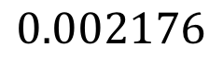
Lesson #2
x | y
10 | 7.46
8 | 6.77
13 | 12.74
9 | 7.11
11 | 7.81
14 | 8.84
6 | 6.08
4 | 5.39
12 | 8.15
7 | 6.42
5 | 5.73
Model
$$y=0.5x+3$$
“Goodness”
$$0.816$$
“Chanceness”
$$0.002176$$

Slide 6
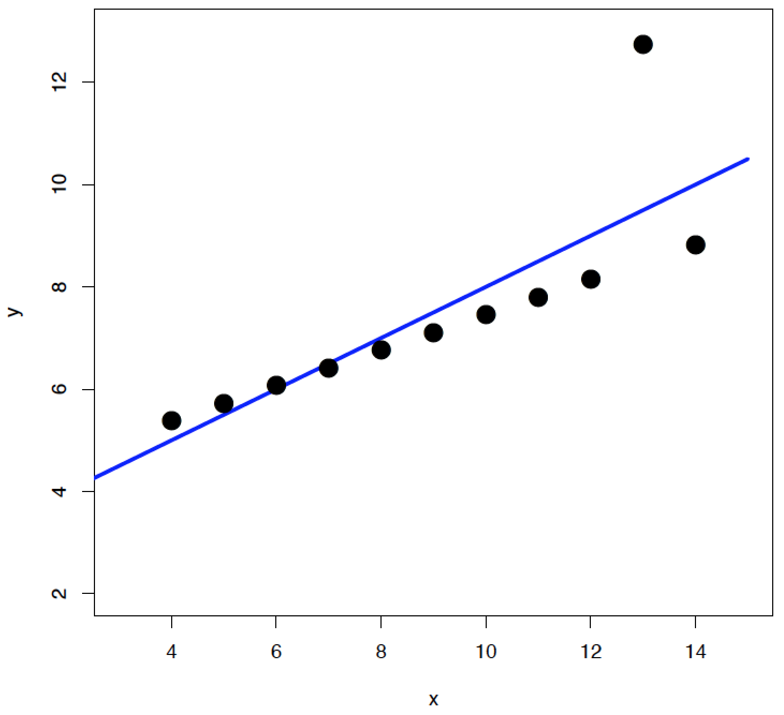
Lesson #2
Model

Slide 7
Lesson #2
Statistics isn’t a substitute for
thinking about your data

Slide 8
Today
Introduction to probability
Probability distributions
The binomial, uniform, and normal distributions

Slide 9
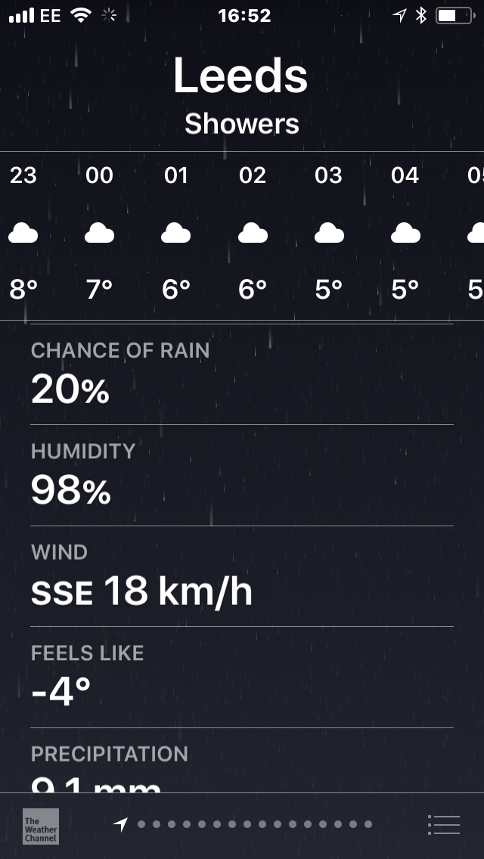
Probability: nomenclature
p(Rain) = 0.2

Slide 10
Probability: rules
0 ≤ p(Anything) ≤ 1
p(Outcome A) + p(Outcome B) + … = 1
p(Rain) + p(No rain) = 1

Slide 11
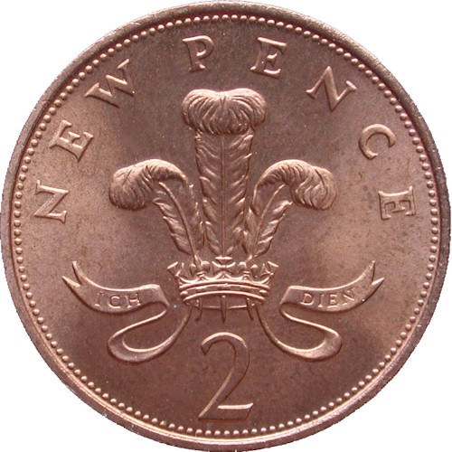
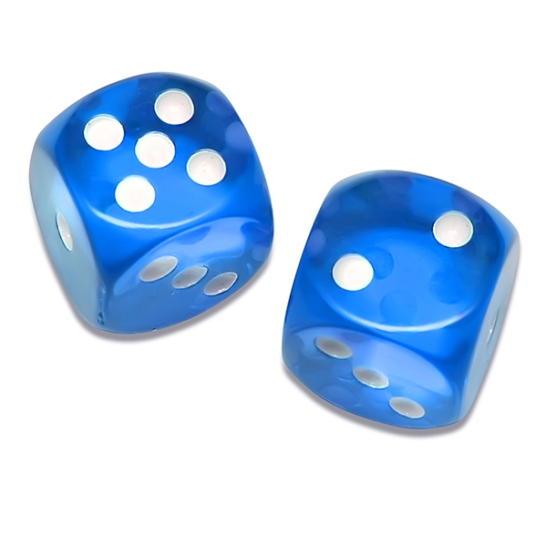
Probability: expectation
Informed by a model
p(Heads) = 0.5
p(6) = 1/6

Slide 12
Probability: expectation
OR / Addition rule
p(Rolling 5) OR p(Rolling 6) = p(5) + p(6) = 1/6 + 1/6 = 1/3
AND / Multiplication rule
p(Rolling 6) AND p(Rolling 6) = p(6) x p(6) = 1/6 x 1/6 = 1/36

Slide 13
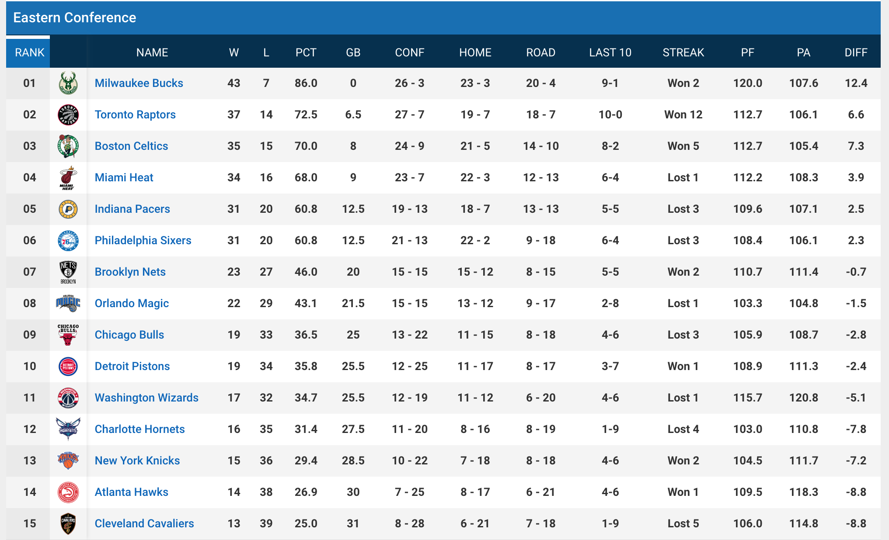
Probability: inference
Informed by empirical data

Slide 14

Probability expectation: coin flips
p(Heads) = 0.5

Slide 15
Probability expectation: coin flips
Exercise

Slide 16
Probability inference: coin flips
Exercise

Slide 17
Probability inference: coin flips
HHTT
HTHT
HTTT
HTTH
THHH
THTT
THHT
HTHH
TTHT
THTH
HHTH
TTTT
TTTH
TTHH
HHHT
HHHH
0
1
2
3
4
N heads

Slide 18
Probability distributions
Frequency
0
1
2
3
4
N heads

Slide 19
Probability distributions
p(0) + p(1) + p(2) + p(3) + p(4) = 1
Density
0
1
2
3
4
N heads

Slide 20
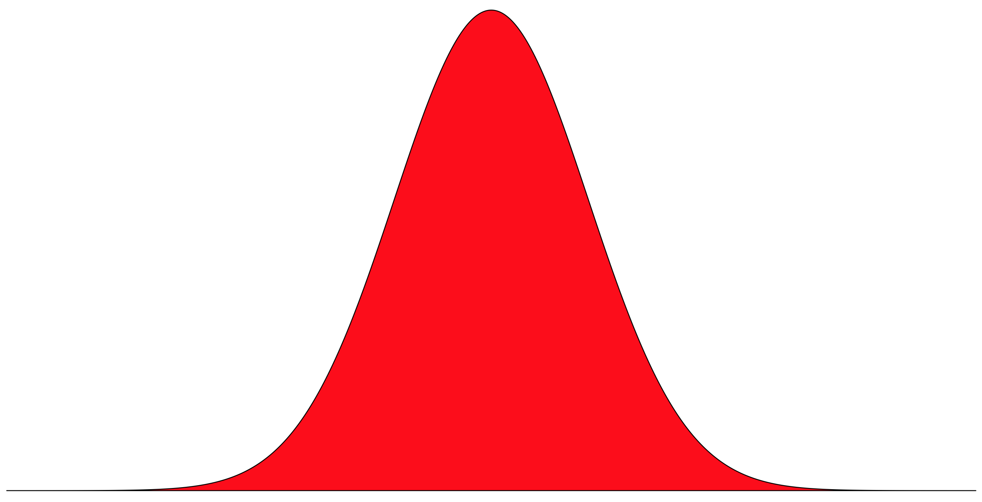
Probability distributions: features
Shape of curve defined by an equation
(the Probability Density Function)
Area under curve = 1
All possible outcomes

Slide 21

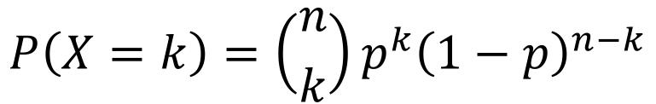
Probability distributions: the binomial
Generalizable to any two outcome scenario
Probability Density Function (PDF)
Density
$$P\left(X=k\right)=\left({n \atop k}\right)p^{k}{\left(1−p\right)}^{n−k}$$
Where k = specific outcome (e.g., 2 Heads)
n = number of trials (e.g., 4 flips)
p = probability of success (e.g., Heads)
0
1
2
3
4
N heads
dbinom(x = k, size = n, prob = p)

Slide 22
Applying the binomial
Q: Are changes in the number of dinosaur species through the Mesozoic distinguishable from flipping a fair coin?

Slide 23
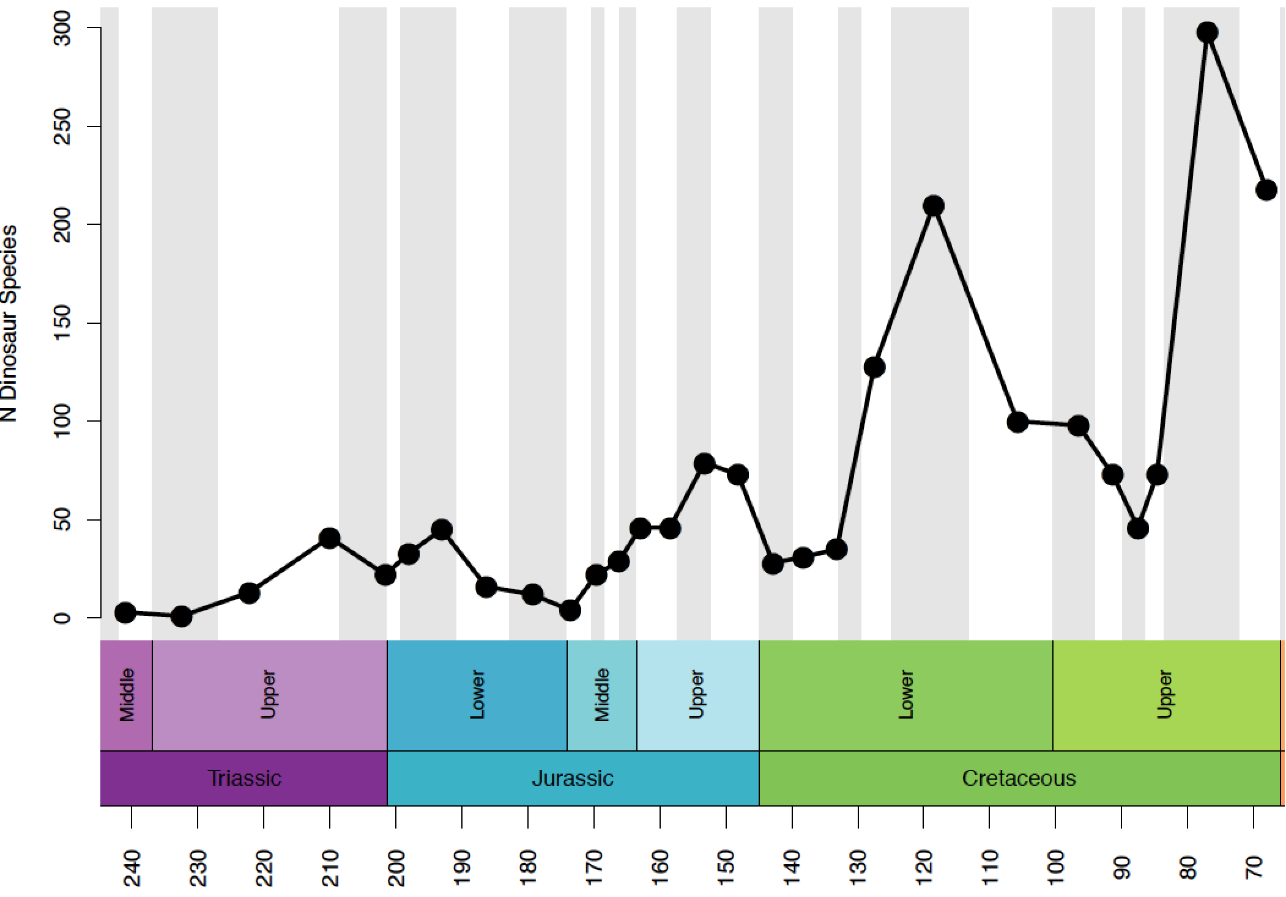
Applying the binomial
Time (Ma)

Slide 24
Applying the binomial
x 12
x 14
dbinom(x = c(0:26), size = 26, prob = 0.5)

Slide 25
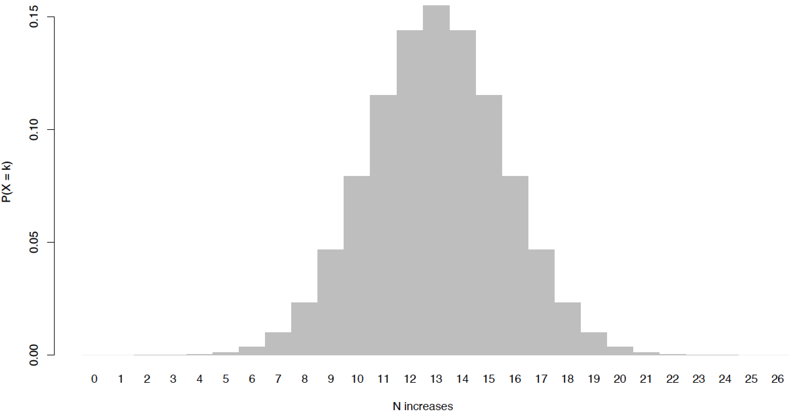
Applying the binomial

Slide 26
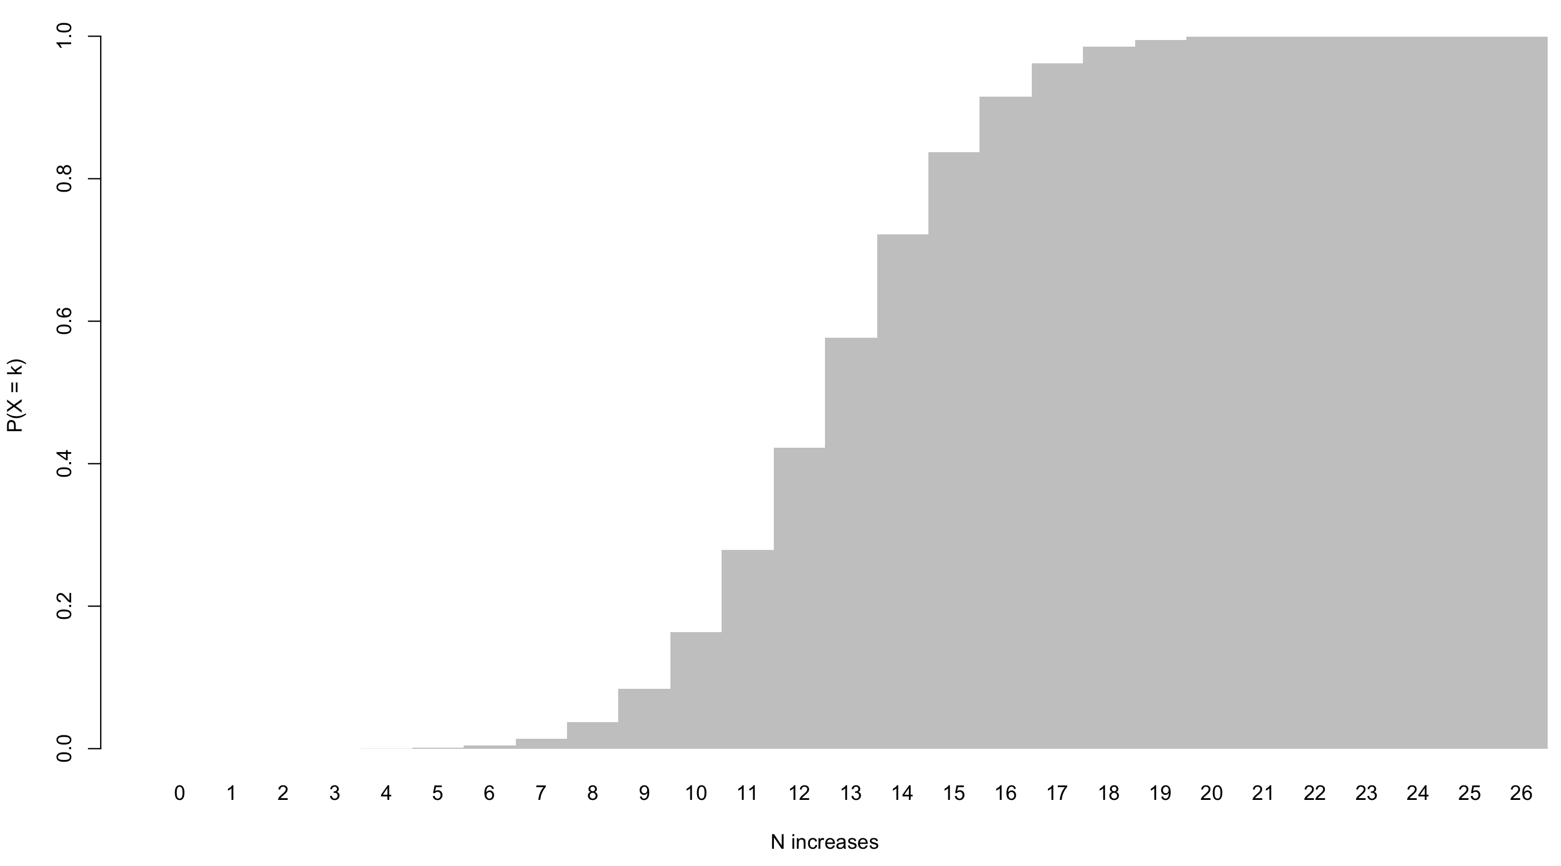
Probability distributions
Cumulative Distribution Function
0.75
Full range of probabilities
Middle 50%
0.25

Slide 27
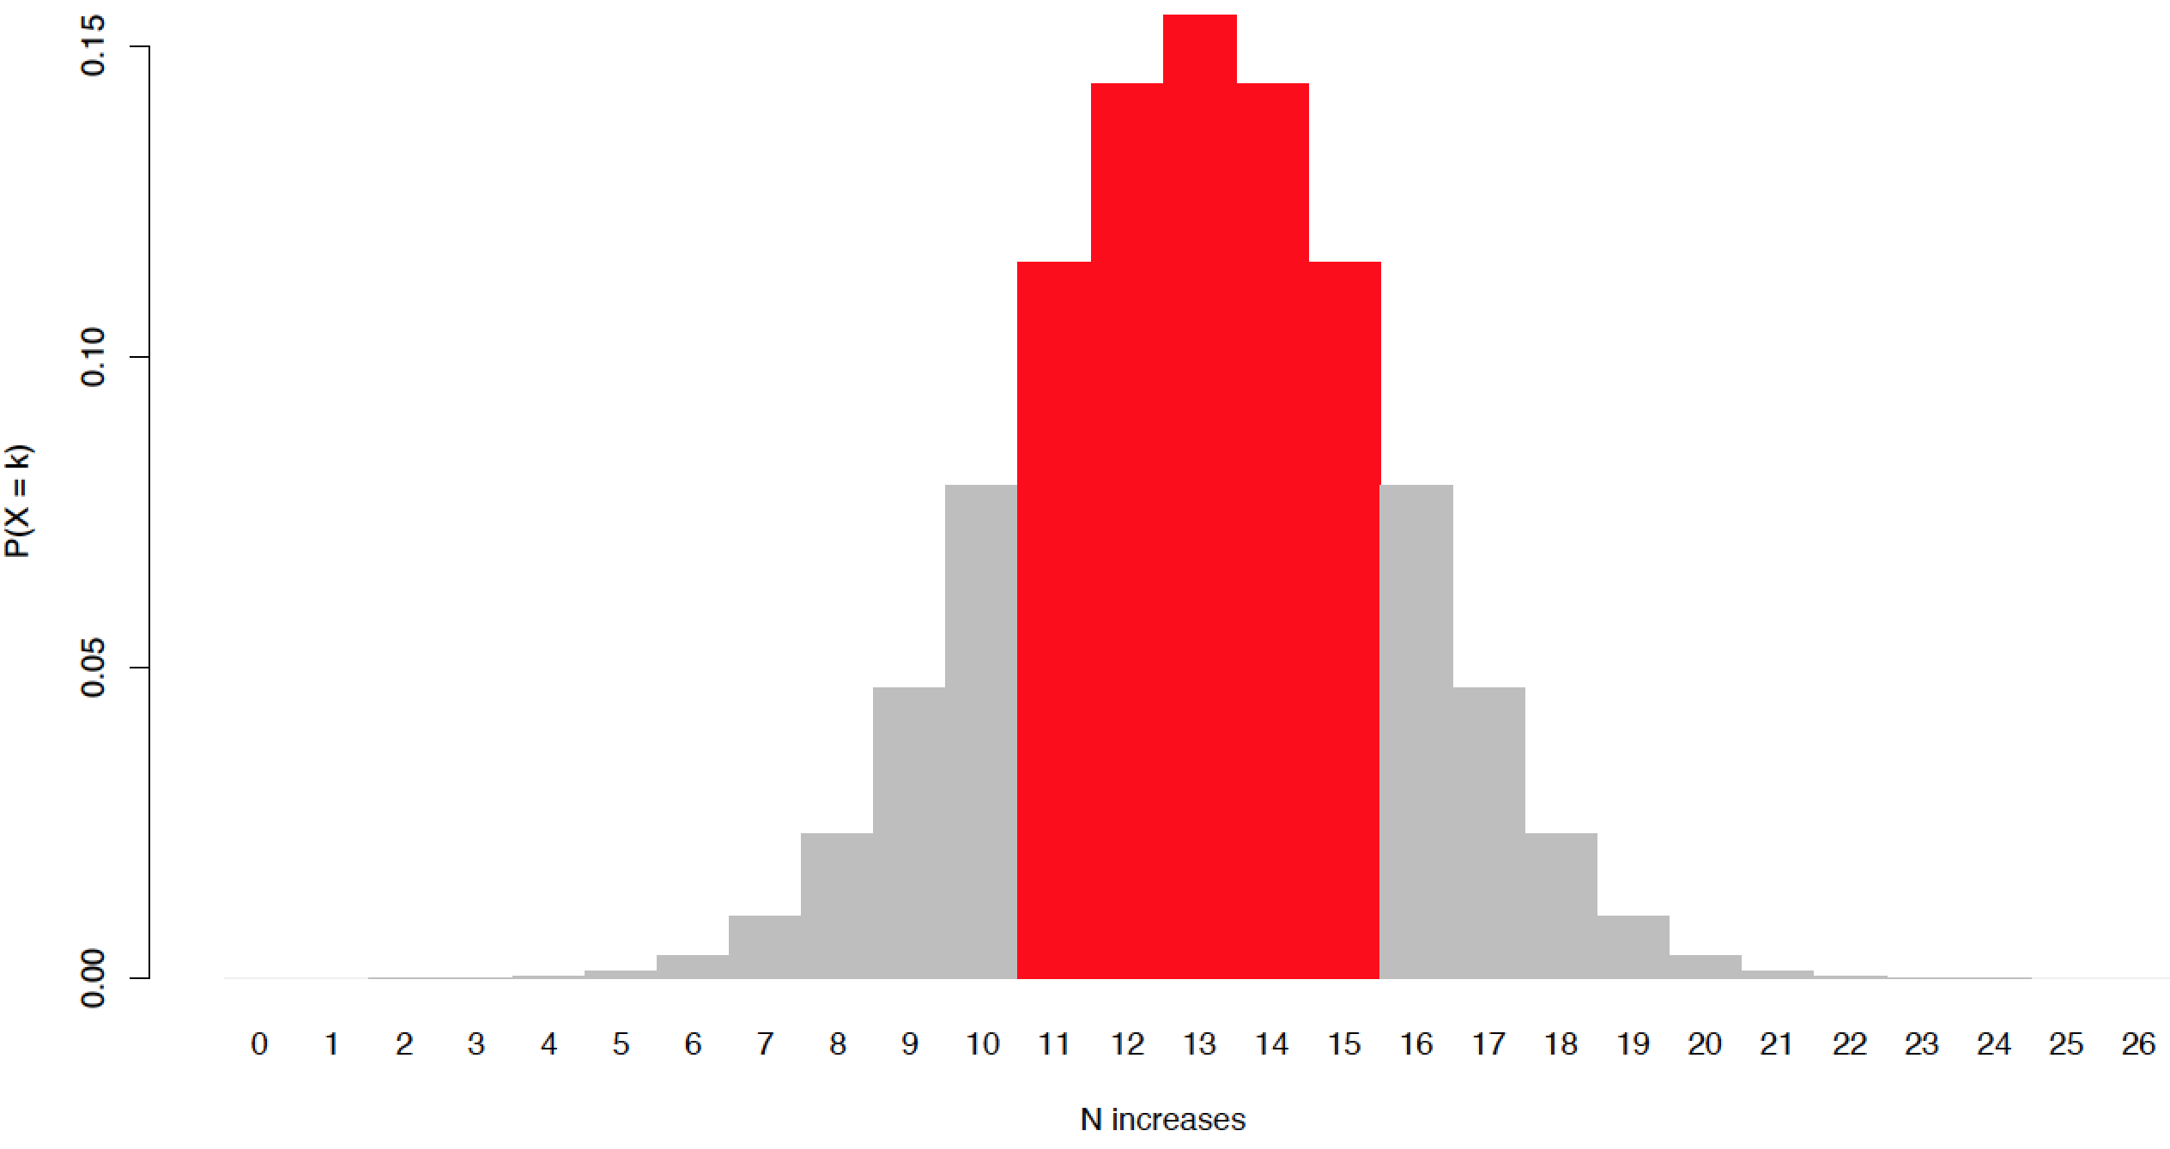
Applying the binomial
≈

Slide 28
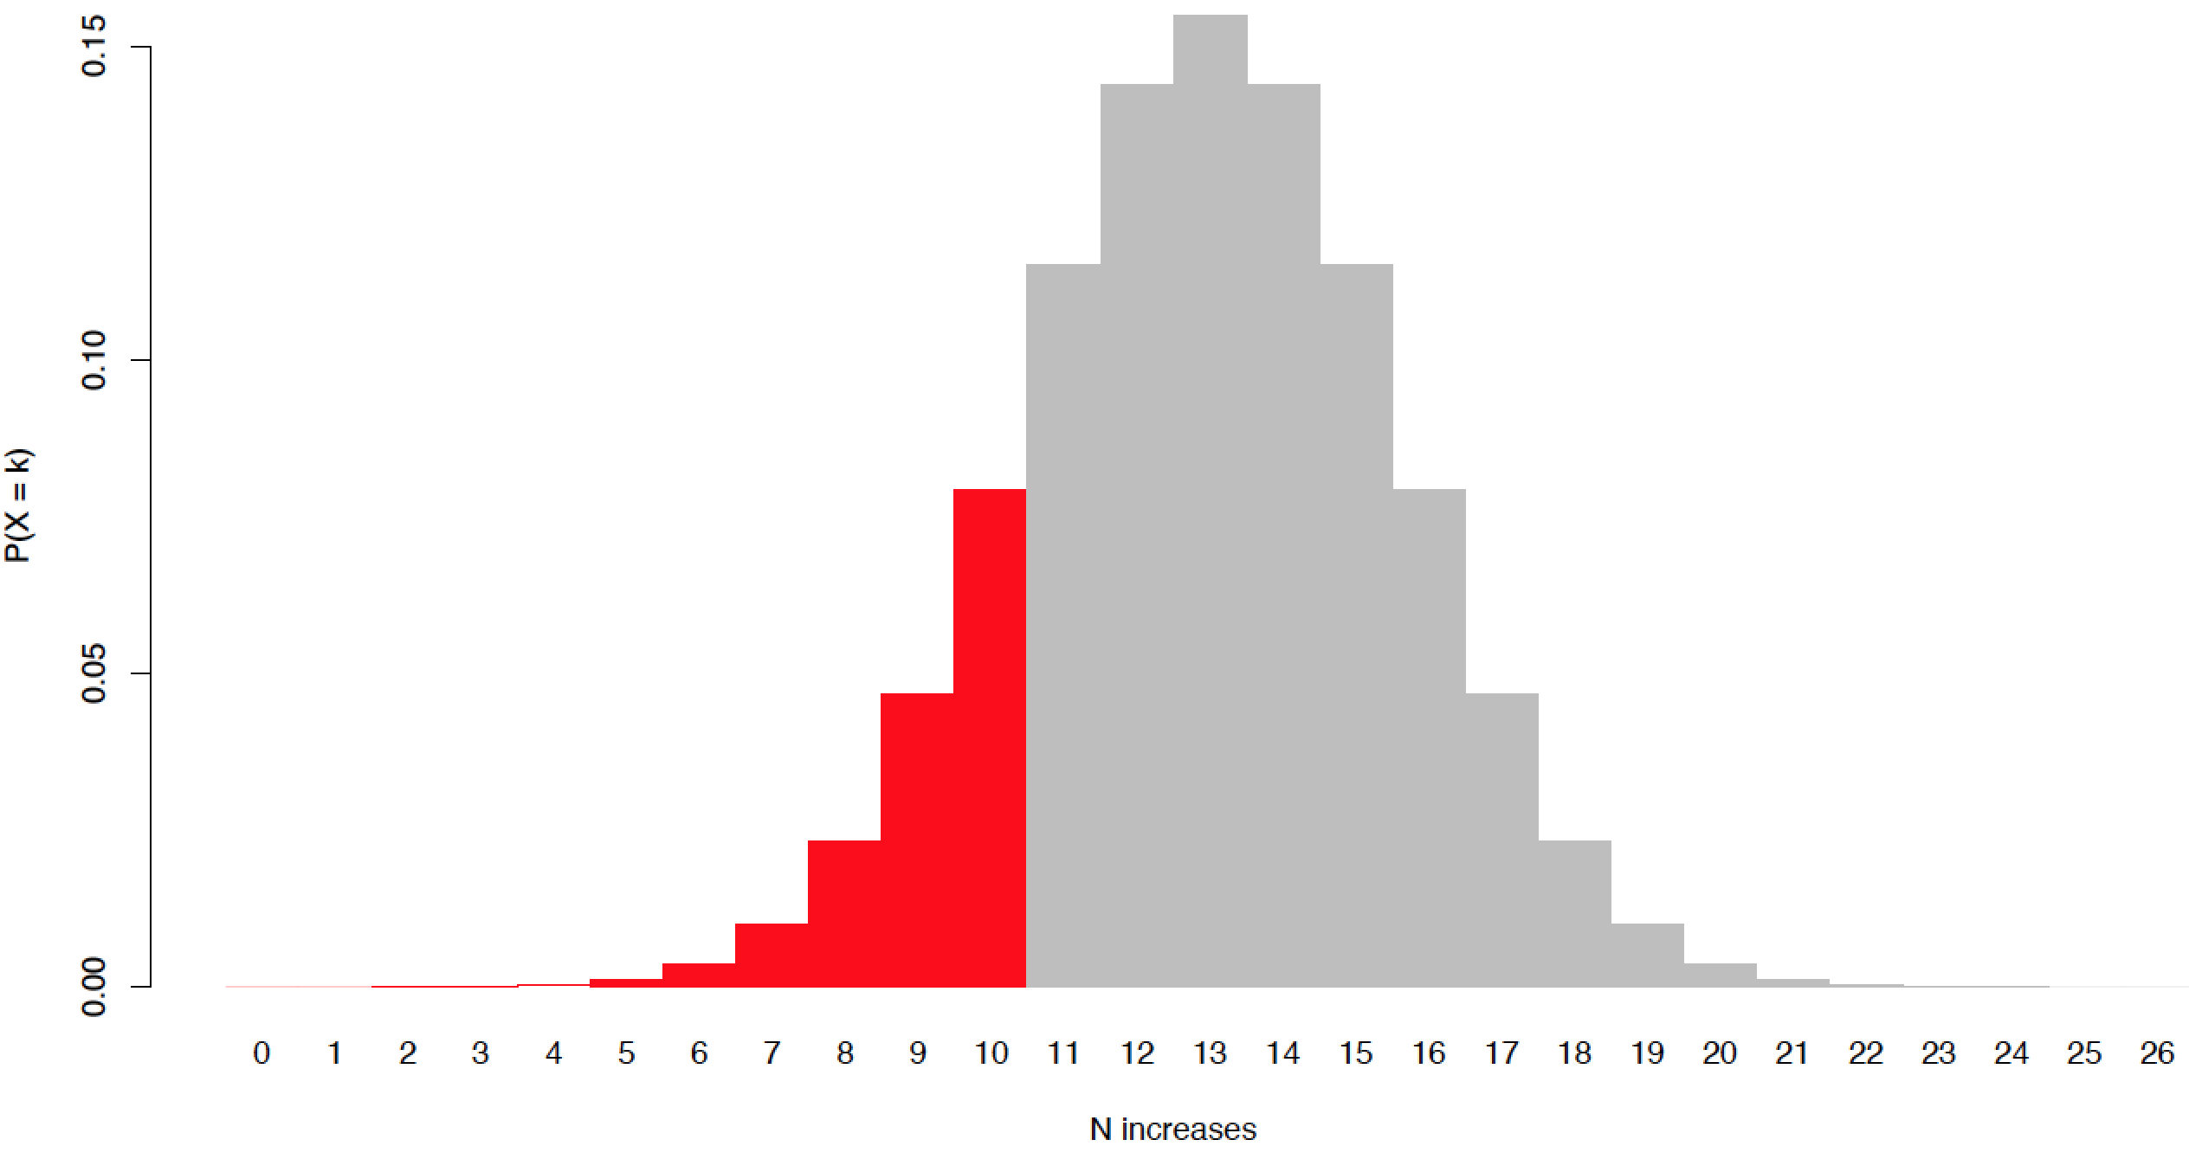
Applying the binomial
>

Slide 29
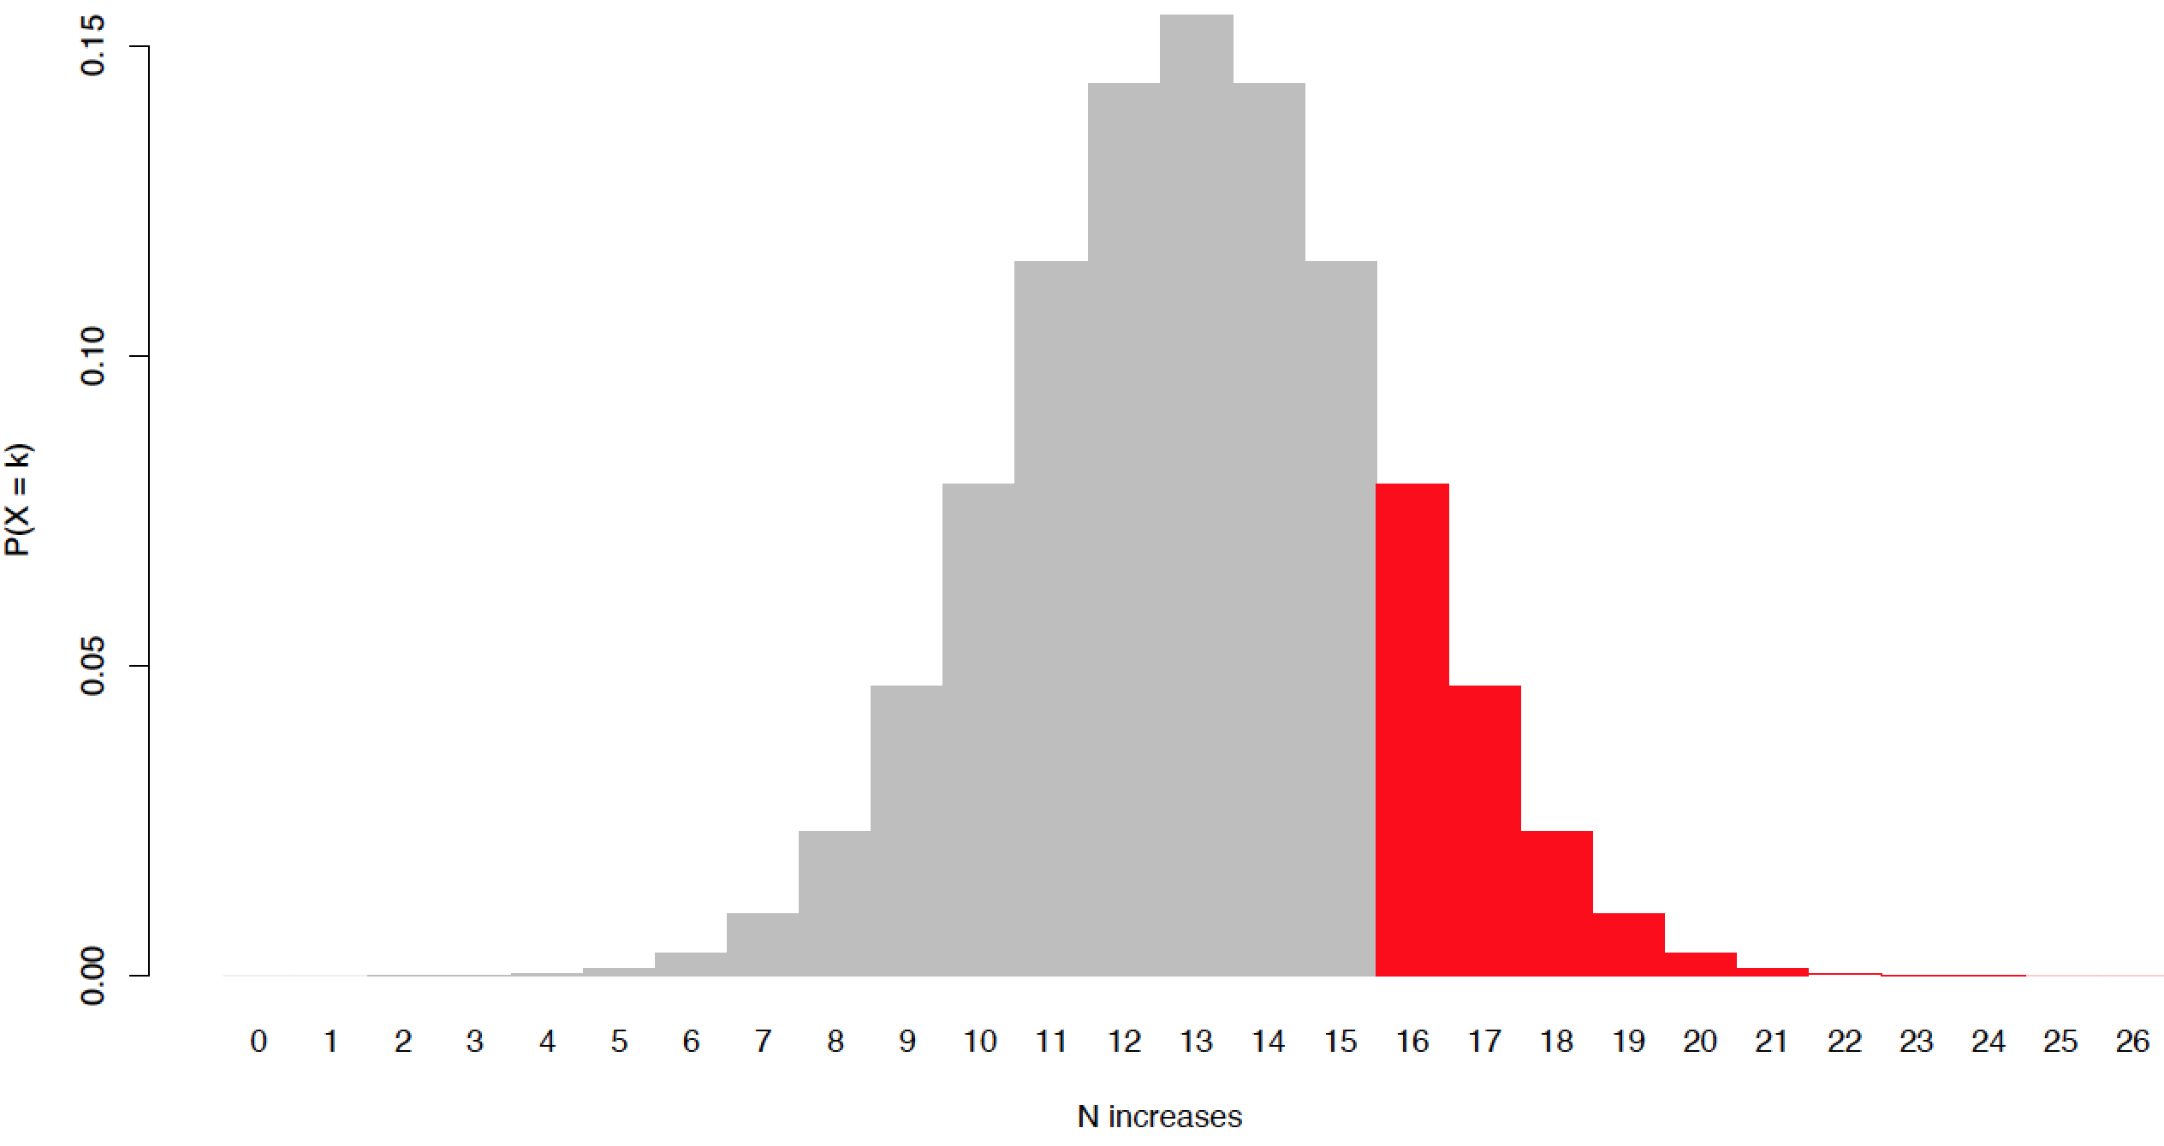
Applying the binomial
>

Slide 30
Applying the binomial
>
≈
>

Slide 31
Applying the binomial
Stage-to-stage changes in the number of dinosaur species are indistinguishable from random coin flips
or
There is no clear bias towards increases (or decreases) in dinosaur species number through the Mesozoic

Slide 32
Applying Lesson #2
Time (Ma)

Slide 33
Rolling dice: expectation
p(1) = p(2) = p(3) = p(4) = p(5) = p(6) = 1/6
p(X = k)
1
2
3
4
5
6
k

Slide 34
Rolling dice: inference
Exercise

Slide 35
Probability distributions: the uniform
p(Any outcome) = p(Any other outcome)
p(X = k)
All possible outcomes

Slide 36
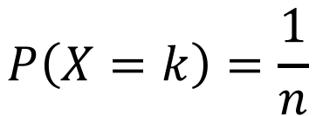
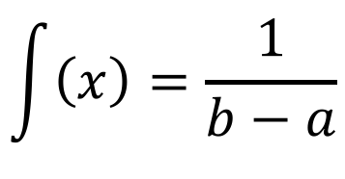
Probability distributions: discrete vs continuous
Discrete
(e.g., discrete uniform)
Continuous
(e.g., continuous uniform)
$$P\left(X=k\right)=\frac{1}{n}$$
$$\int{\left(x\right)}=\frac{1}{b−a}$$
a
b
p(X = k)
f(x)
Limited specific outcomes
All intermediates possible

Slide 37
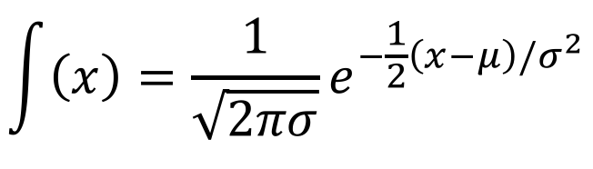
Probability distributions: the normal
Probability Density Function
$$\int{\left(x\right)}=\frac{1}{\sqrt{2πσ}}e^{−\frac{1}{2}\left(x−μ\right)/σ^{2}}$$
-∞
+∞

Slide 38
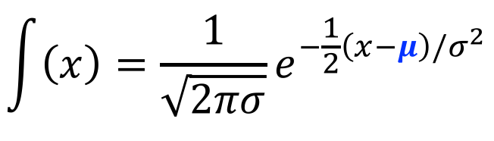
Probability distributions: the normal
Probability Density Function
μ
$$\int{\left(x\right)}=\frac{1}{\sqrt{2πσ}}e^{−\frac{1}{2}\left(x−μ\right)/σ^{2}}$$
-∞
+∞

Slide 39
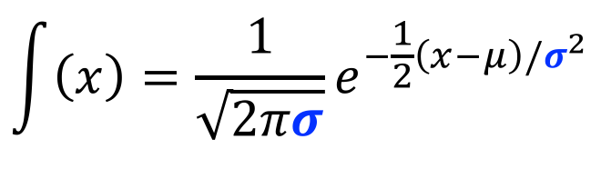
Probability distributions: the normal
Probability Density Function
$$\int{\left(x\right)}=\frac{1}{\sqrt{2πσ}}e^{−\frac{1}{2}\left(x−μ\right)/σ^{2}}$$
Middle
68.2%
-∞
-1σ
1σ
+∞

Slide 40
Probability distributions: the normal
Probability Density Function
$$\int{\left(x\right)}=\frac{1}{\sqrt{2πσ}}e^{−\frac{1}{2}\left(x−μ\right)/σ^{2}}$$
dnorm(x = x, mean = mu,
sd = sigma)
-∞
+∞

Slide 41
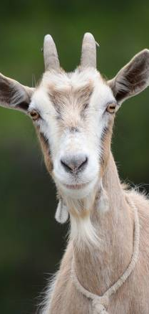
Goats!

Slide 42
Goats!
Option A
Option B
(Pick one)
(Pick one)
Stick with initial door
Switch to other door
Stick or switch, p(Win car) is same
p(Win car) = 1/3
p(Win car) = 1/2
p(Win car) = 2/3

Slide 43
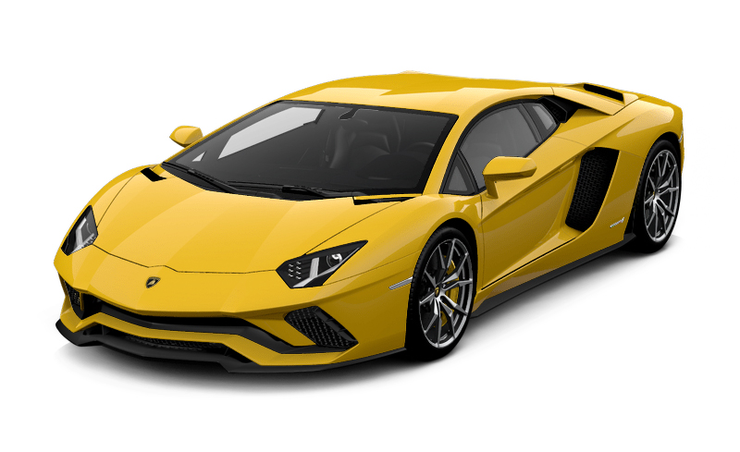
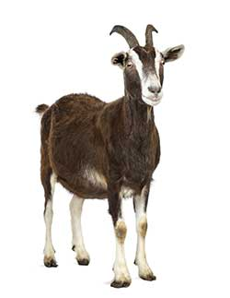
Goats!
Pick
Shown
Stick
Switch
#1 or #2
#1 or #2
#1
#2
#1
#2
#1
#2

